Slide 1
WELCOME TO
POWER POINT PRESENTATION
ON
COMPUTER

Slide 2
DEFINITION
Computer is an electronic device that is designed to work with Information,It accepts the data and instructions,stores in its memory,processs and gives result to the user.
The term computer is derived from the Latin term ‘computer’, this means to calculate or programmable machine.

Slide 3
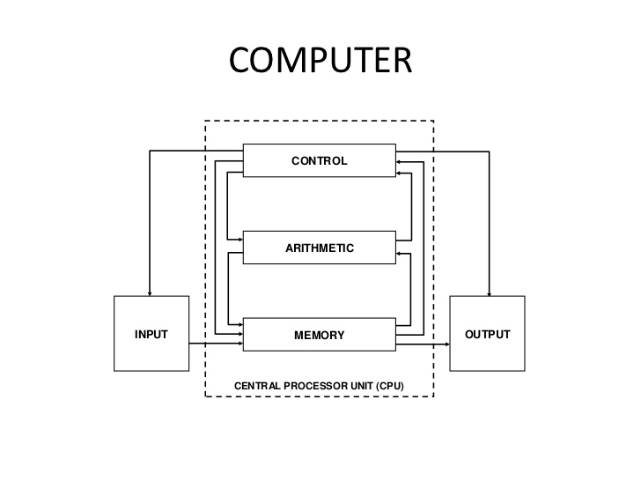

Slide 4
INPUT /OUTPUT DEVICES
INPUT
OUTPUT
The devices which are used to give data and instructions to the computer are called Input Devices
Keyboard
mouse
joystick
light pen etc.
The devices which are used to display the results or information are called Output Devices.
Monitor
Printer
Speaker
Plotter

Slide 5
MEMORY
A memory is just like a human brain. It is used to store data and instructions. Computer memory is the storage space in the computer, where data is to be processed and instructions required for processing are stored.
Memory is primarily of three types −
Cache Memory
Primary Memory/Main Memory
Secondary Memory

Slide 6
Measurements for Memory & Storage
1 bit (binary digit*) = the value of 0 or 1
8 bits = 1 byte
1024 bytes = 1 kilobyte
1024 kilobytes = 1 megabyte
1024 megabytes = 1 gigabyte
1024 gigabytes = 1 terabyte
1024 terabytes = 1 petabyte

Slide 7
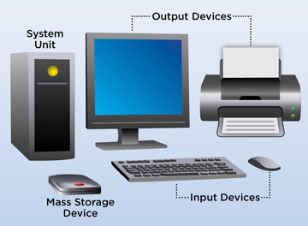
COMPUTER

Slide 8
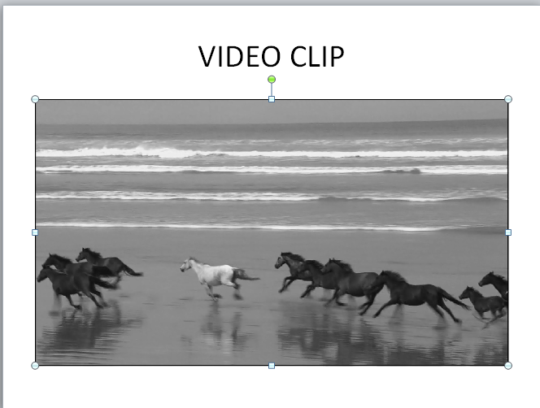

Slide 9
Link to a slide in the same presentation,
In Normal view, select the text, shape, or picture that you want to use as a hyperlink(CTRL+K).
On the Insert tab, in the Links group, click Hyperlink.
In the Insert Hyperlink dialog box, under Link to, click Place in This Document.
Do one of the following:
CLICK HERE TO VIEW
WORD FILE
EXCEL FILE

Slide 10
THANK YOU
ONE AND ALL…….

